Slide 1
CAP Theorem

Slide 2
Distributed Databases
A distributed data store is a computer network where information is stored on more than one node, often in a replicated fashion
It is usually specifically used to refer to either a distributed database where users store information on a number of nodes, or a computer network in which users store information on a number of peer network nodes
Distributed databases are usually non-relational databases that enable a quick access to data over a large number of nodes
Some distributed databases expose rich query abilities while others are limited to a key-value store semantics

Slide 3
CAP Theorem
The CAP theorem(Brewer's theorem) implies that in the presence of a network partition, one has to choose between consistency and availability
Three properties of a system
Consistency (all copies have same value)
Availability (system can run even if parts have failed)
All nodes can still accept reads and writes
Partition Tolerance (Even if part is down, others can take over)

Slide 4
CAP Theorem
When a network partition failure happens should we decide to
Cancel the operation and thus decrease the availability but ensure consistency
Proceed with the operation and thus provide availability but risk inconsistency
CAP “Theorem”:
You can have at most two of these three properties for any system
Pick two !!!

Slide 5

The CAP Theorem
Let us assume two nodes on opposite sides of a network partition:
Availability + Partition Tolerance forfeit Consistency
Consistency + Partition Tolerance entails that one side of the partition must act as if it is unavailable, thus forfeiting Availability
Consistency + Availability is only possible if there is no network partition, thereby forfeiting Partition Tolerance

Slide 6
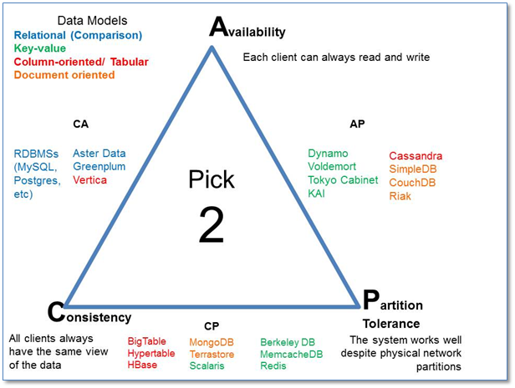
CAP Theorem

Slide 7
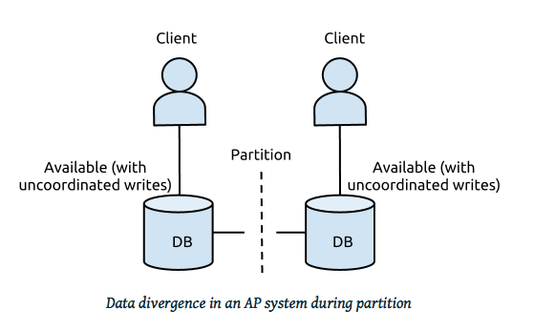
Example
In distributed systems, CA is not a choice
Either select AP or CP
Network Failure
If select Availability ➔ Loose Consistency (AP Design)
If select Consistency ➔ Loose Availability (CP Design)

Slide 8
Large-Scale Databases
When companies such as Google and Amazon were designing large-scale databases, 24/7 Availability was a key
A few minutes of downtime means lost revenue
When horizontally scaling databases to 1000s of machines, the likelihood of a node or a network failure increases tremendously
Therefore, in order to have strong guarantees on Availability and Partition Tolerance, they had to sacrifice “strict” Consistency (implied by the CAP theorem)

Slide 9
Trading-Off Consistency
Maintaining consistency should balance between the strictness of consistency versus availability/scalability
Good-enough consistency depends on your application

Slide 10
Trading-Off Consistency
Maintaining consistency should balance between the strictness of consistency versus availability/scalability
Good-enough consistency depends on your application
Loose Consistency
Strict Consistency
Easier to implement, and is efficient
Generally hard to implement, and is inefficient

Slide 11
Availability
Traditionally, thought of as the server/process available five 9’s (99.999 %)
Failures are rare
In modern commodity distributed systems:
Want a system that is resilient in the face of network disruption
Use Replication

Slide 12
The BASE Properties
The CAP theorem proves that it is impossible to guarantee strict Consistency and Availability while being able to tolerate network partitions
This resulted in databases with relaxed ACID guarantees
In particular, such databases apply the BASE properties:
Basically Available: the system guarantees Availability
Soft-State: the state of the system may change over time
Eventual Consistency: the system will eventually become consistent

Slide 13
Eventual Consistency
A database is termed as Eventually Consistent if:
All replicas will gradually become consistent in the absence of updates

Slide 14

Eventual Consistency
A database is termed as Eventually Consistent if:
All replicas will gradually become consistent in the absence of updates
Webpage-A
Webpage-A
Webpage-A
Webpage-A
Webpage-A
Webpage-A
Event: Update Webpage-A
Webpage-A
Webpage-A
Webpage-A
Webpage-A
Webpage-A
Webpage-A

Slide 15
Eventual Consistency: A Main Challenge
But, what if the client accesses the data from different replicas?
Webpage-A
Webpage-A
Webpage-A
Webpage-A
Webpage-A
Webpage-A
Event: Update Webpage-A
Webpage-A
Webpage-A
Webpage-A
Webpage-A
Webpage-A
Webpage-A
Protocols like Read Your Own Writes (RYOW) can be applied!

Slide 16
Eventual Consistency
When no updates occur for a long period of time:
Eventually all updates will propagate through the system and all the nodes will be consistent
For a given accepted update and a given node:
Eventually either the update reaches the node or the node is removed from service

Slide 17


What does NoSQL Not Provide
No built-in join
No ACID transactions
No SQL
ISA
Follows

Slide 18
SQL vs NoSQL
SQL databases are relational, NoSQL are non-relational.
SQL databases use structured query language and have a predefined schema. NoSQL databases have dynamic schemas for unstructured data.
SQL databases are vertically scalable, NoSQL databases are horizontally scalable.
SQL databases are table based, while NoSQL databases are document, key-value, graph or wide-column stores.

Slide 19
SQL vs NoSQL
These databases are not suited for hierarchical data storage. These databases are best suited for hierarchical data storage.
SQL databases are better for multi-row transactions, NoSQL are better for unstructured data like documents or JSON.
SQL databases follow ACID properties (Atomicity, Consistency, Isolation and Durability) whereas the NoSQL database follows the Brewers CAP theorem (Consistency, Availability and Partition tolerance)

